Slide 1
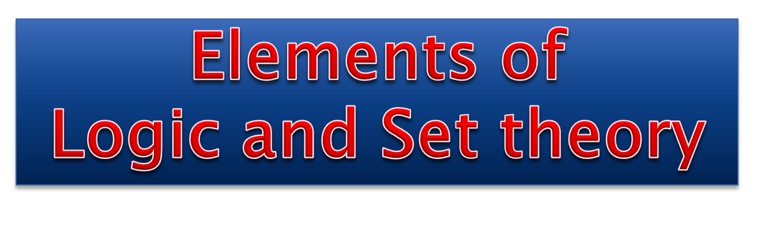

Slide 2

SET
A collection of well-defined objects.
The objects belonging to a set are called its elements or members.
Eg : Set of pages in a book
The set of prime numbers
Can you add more?

Slide 3
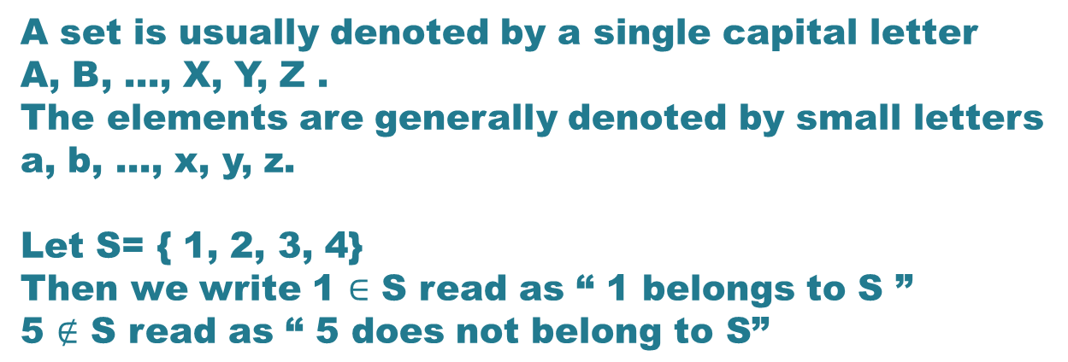

Slide 4

Which of the following are well-defined sets?
All the colours in a rainbow
All the points that lie on a straight line
All the honest members in the family
All the consonants of the English alphabets
All the tall boys of the college
All the efficient doctors of the hospital
All the hardworking teachers in a school
All the prime numbers less than 100
All the letters in the word GEOMETRY

Slide 5
Representation
Tabular form/ Roster form
In this, elements are enclosed in curly brackets after
separating them by commas.
Eg: The set of positive odd integers less than 13 is written as
A = {1, 3, 5, 7, 9, 11}
Symbolic form/ Set Builder form
In this, a set is written as {x/P(x)} where x is an arbitrary element of the set and P(x) is the property satisfied by this element. In symbolic form, the set A can be written as
A = { x/ x is an odd positive integer less than 13}

Slide 6
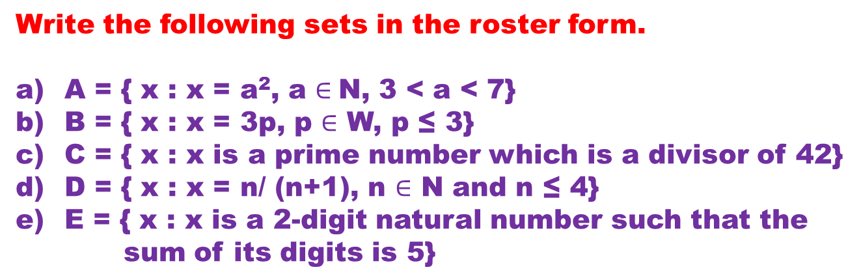
Answers:
A = {16, 25, 36}
B = {0, 3, 6, 9}
C = {2, 3, 7}
D = {1/2, 2/3, 3/4, 4/5}
E = {14, 23, 32, 41, 50}

Slide 7
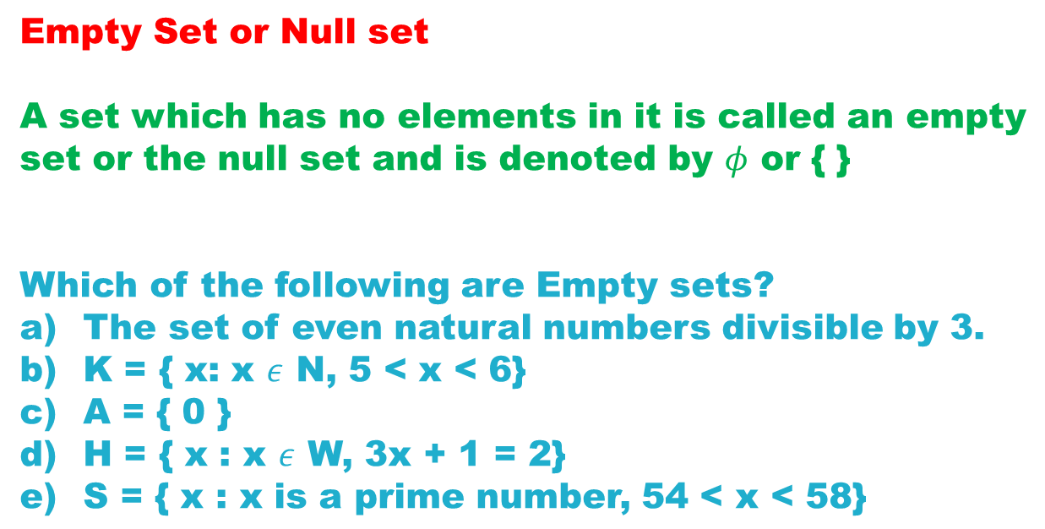
Ans: b, d, e

Slide 8
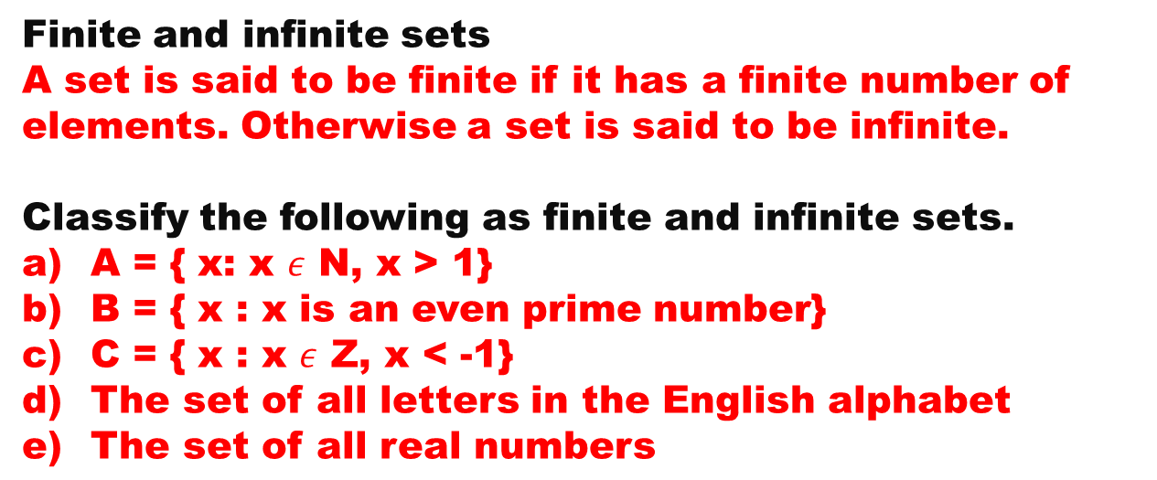
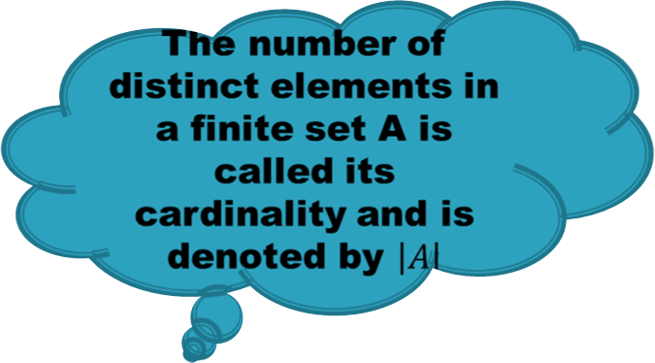
Ans: Finite sets: b, d
Infinite sets: a, c, e

Slide 9
The cardinality of the set of letters in the word FOLLOW is
a) 4
b) 6
c) 3
d) 5

Slide 10
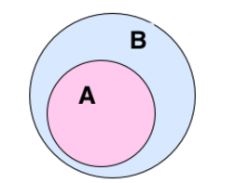
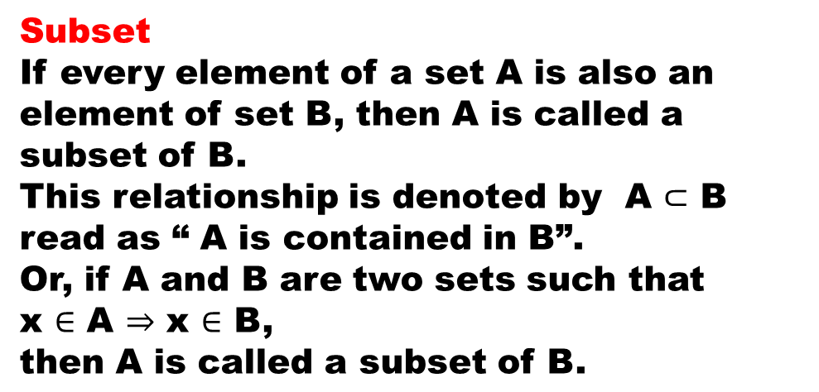
B is called a ________
of A
superset

Slide 11
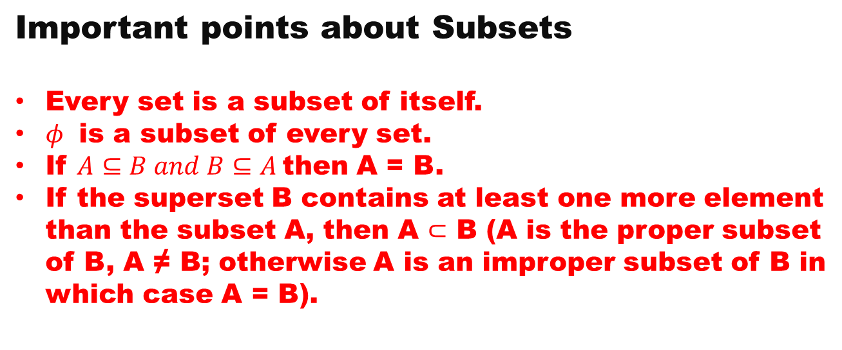

Examples of proper subsets?

Slide 12
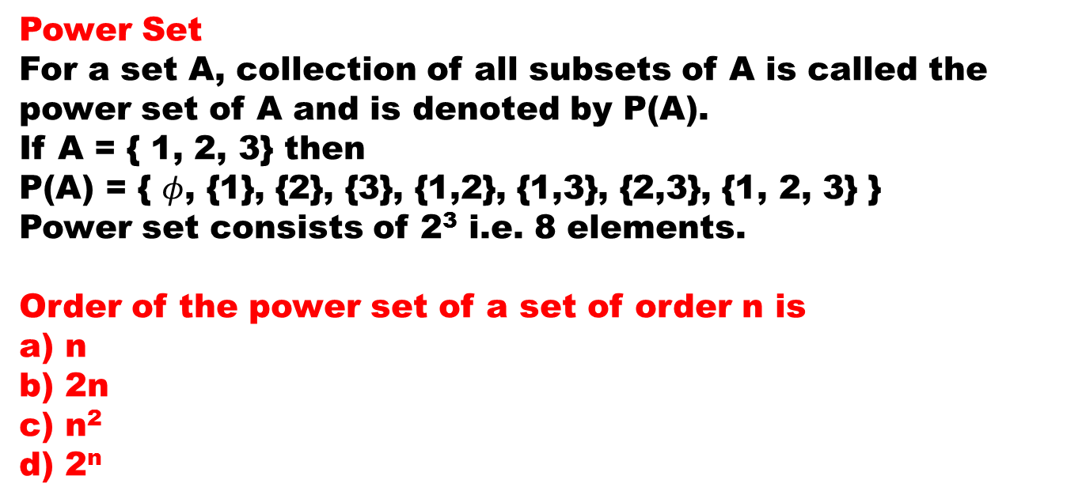

Yooooo!
I got it right.

Slide 13
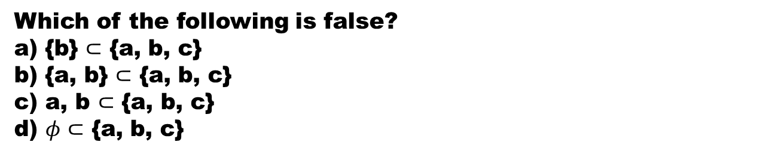
The number of elements in the power set of the set { {a, b}, c} is
a) 8
b) 4
c) 3
d) 16
Ans: c, b

Slide 14
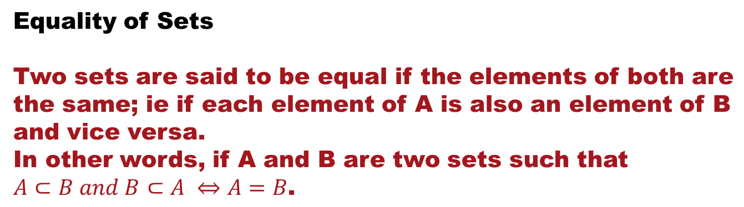
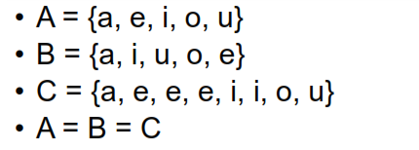
Things to remember
The change in the order of the elements does not matter.
Repetition of an element is immaterial.

Slide 15
Which of the following sets are equal?
a) A = {1, 2, 1, 2, 1, 2}
B = {2, 1}
C = {x: x² – 3x + 2 = 0}
A = {1, 2, 2, 3}
B = {x: x² – 2x + 1 = 0}
C = {x: x³ - 6x² + 11x - 6 = 0}
D = {3, 2, 1}
Ans: a) A = B = C
b) A = C = D

Slide 16
Universal Set
Universal set is that set which has all the sets under investigation as its subsets. It is generally denoted by ‘U’.
The set of all letters of English alphabet is a universal set of the sets of the form {a, e, i, o, u}, {b, x, m, t}.
What is the smallest possible universal set for the given sets?

Slide 17
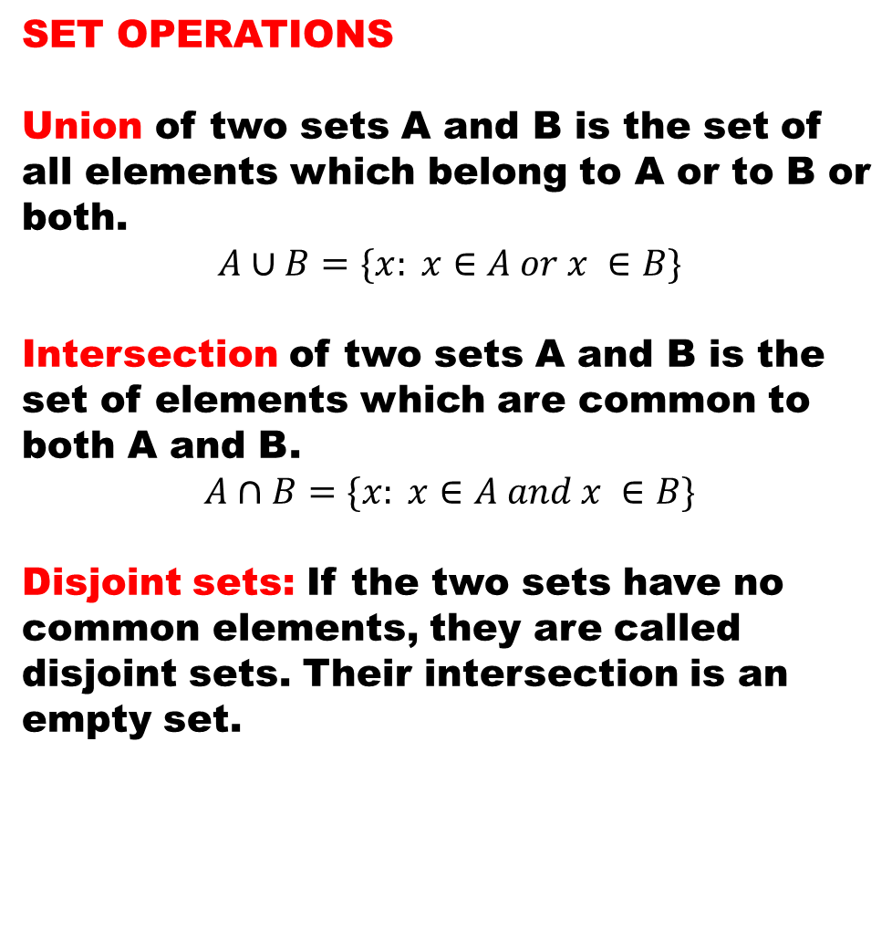
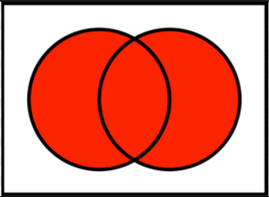
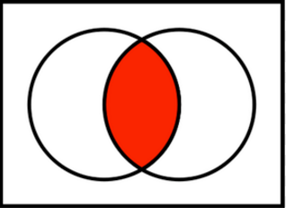
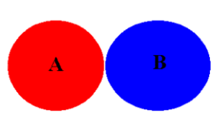

Slide 18
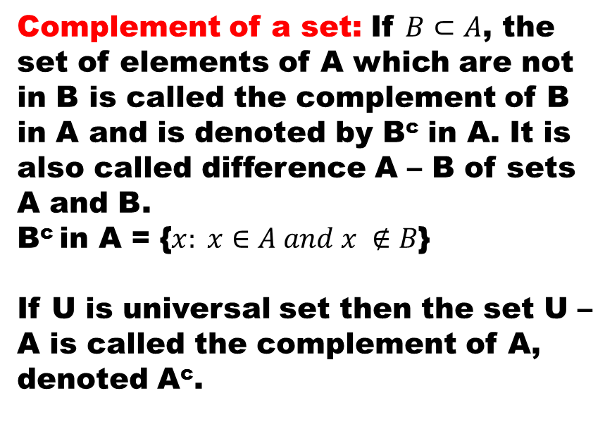
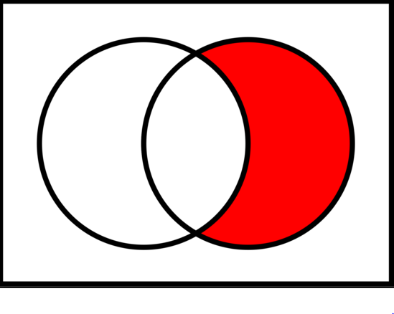
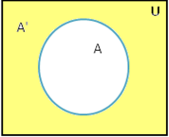

Slide 19
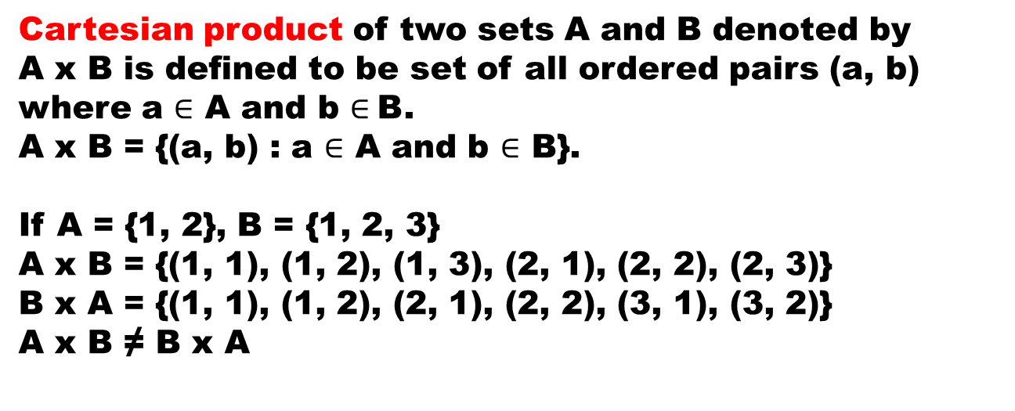

Slide 20
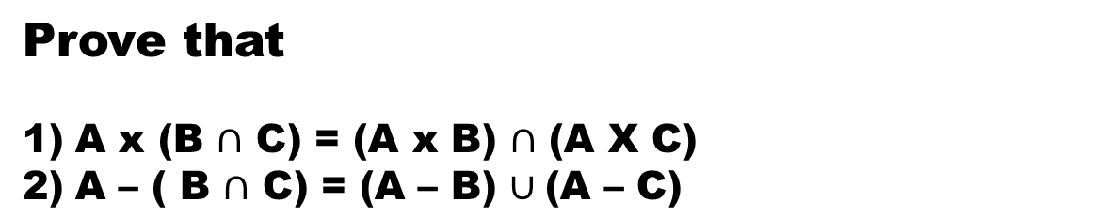

Slide 21
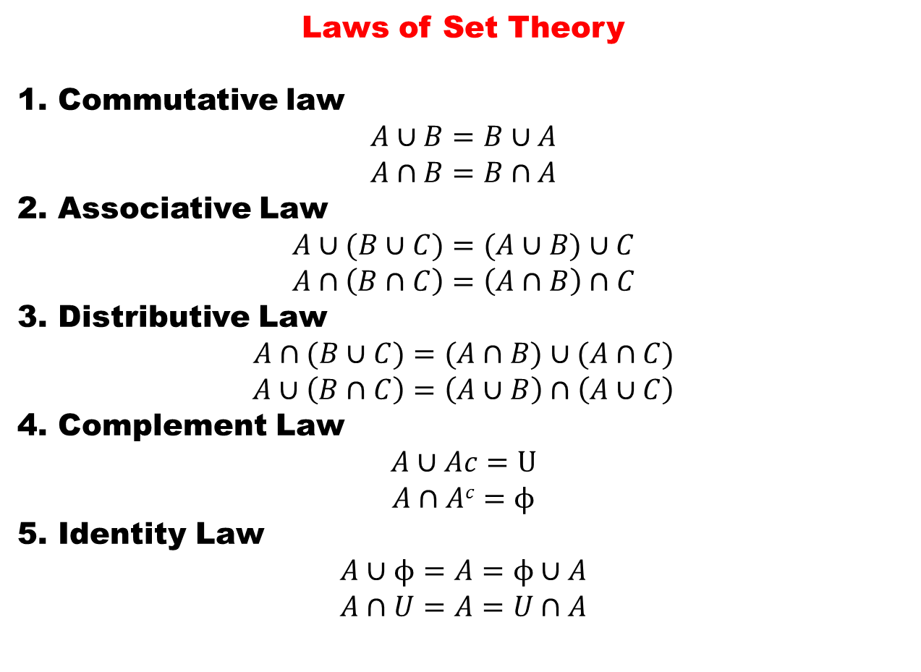

Slide 22
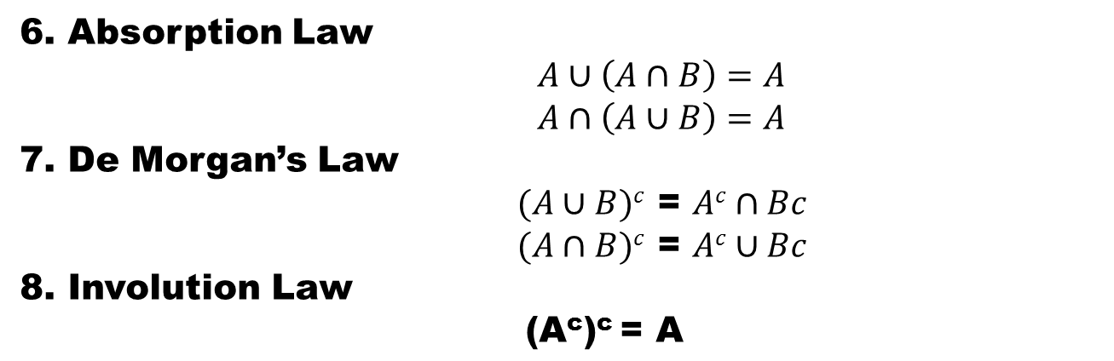
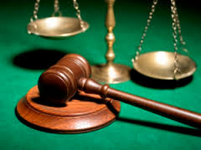

Slide 23
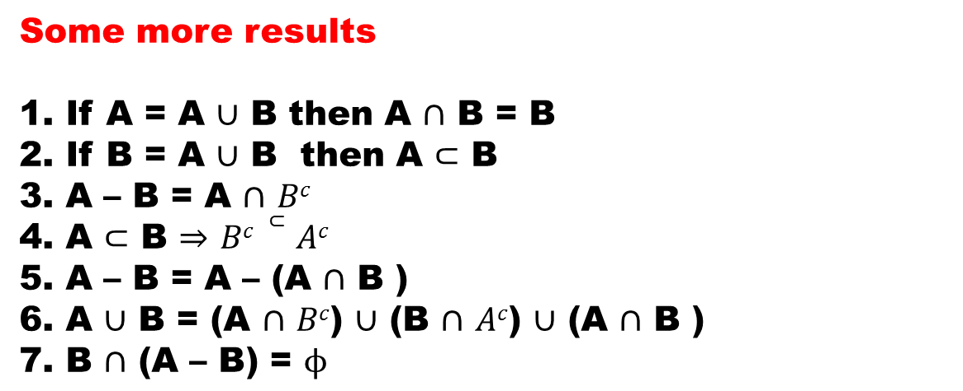

Slide 24
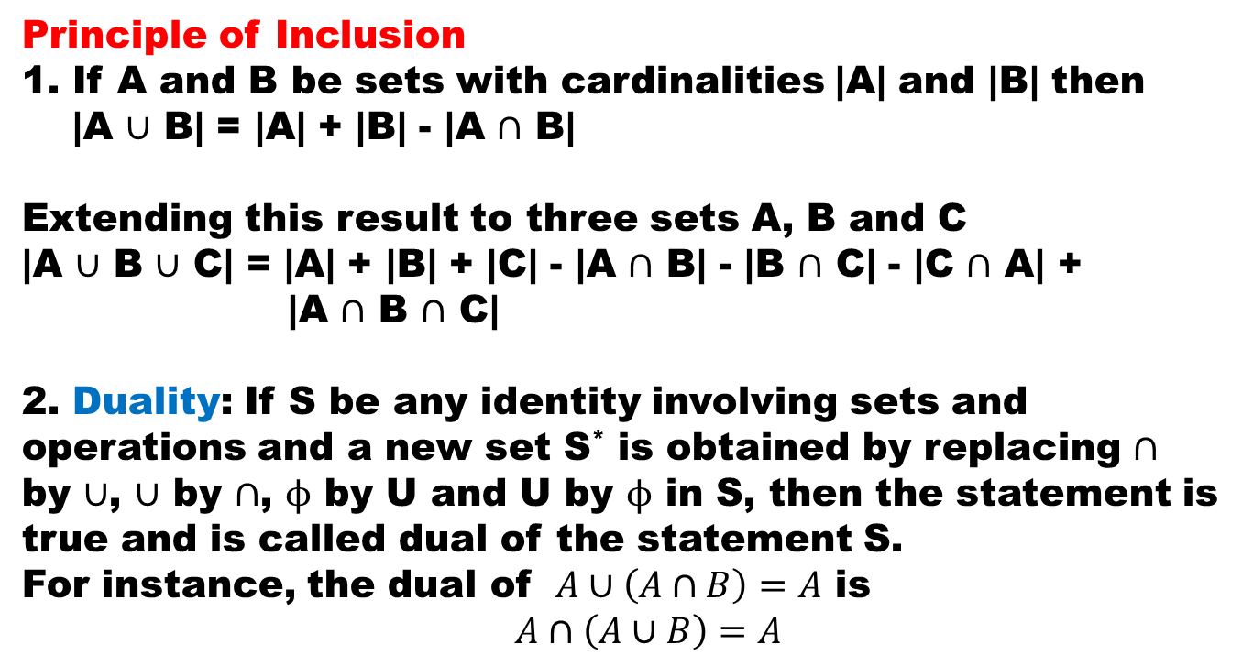

Slide 25
In a survey conducted on 200 people, it was found that 140 are smokers while 80 are alcoholic and 40 are both smokers and alcoholics. Find how many are neither smokers nor alcoholics.
Out of a class of 153 students, 54 have taken History, 63 have taken Geography, 62 have taken Economics, and 43 have taken Geography and History, 45 have taken History and Economics, 46 have taken Geography and Economics and 37 have taken all the three subjects. How many of the students have not taken any of these three subjects?
How many integers between 1 and 468 are divisible by 3 but not by 5?
How many integers are between 1 and 200 which are divisible by any of the integers 2, 3 and 5?

Slide 26
In a beauty contest, half the number of experts voted for Mr. A and two thirds voted for Mr. B. 10 voted for both and 6 did not vote for either. How many experts were there in all?
a) 24
b) 36
c) 18
d) None of these
In a room containing 28 people, there are 18 people who speak English, 15 people who speak Hindi and 22 people who speak Kannada, 9 persons speak both English and Hindi, 11 persons speak both Hindi and Kannada whereas 13 persons speak both Kannada and English. How many people speak all the three languages?
a) 6
b) 7
c) 8
d) 9

Slide 27




